Slide 1
Potential Method
By
GURURAJ
Assistant Professor-Selection Grade
Department of Computer Science & Engineering
M.I.T Manipal

Slide 2
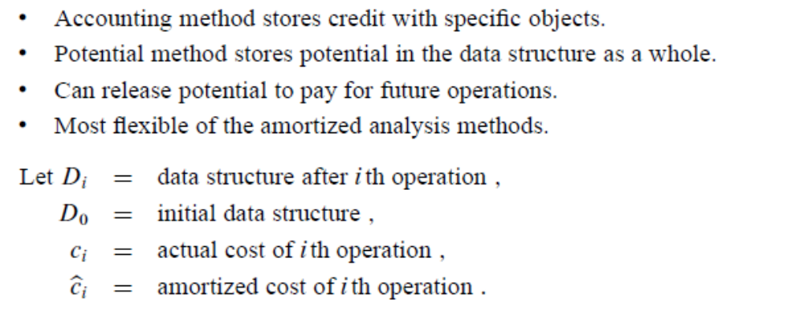
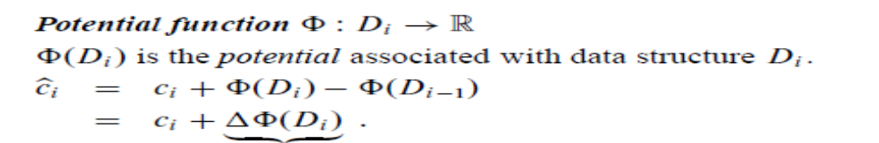
The Potential Method

Slide 3
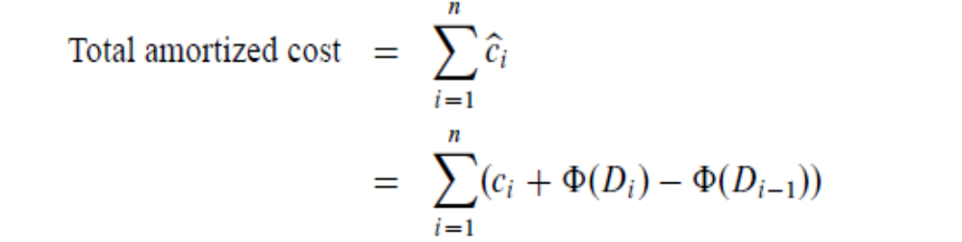
The Potential Method
Let D_{k} denote a data structure after the k^{th} operation
initially starting with a data structure D₀.
A function Φ assigning nonnegative real numbers to data structures such that Φ(D₀)=0 is called a potential function.

Slide 4
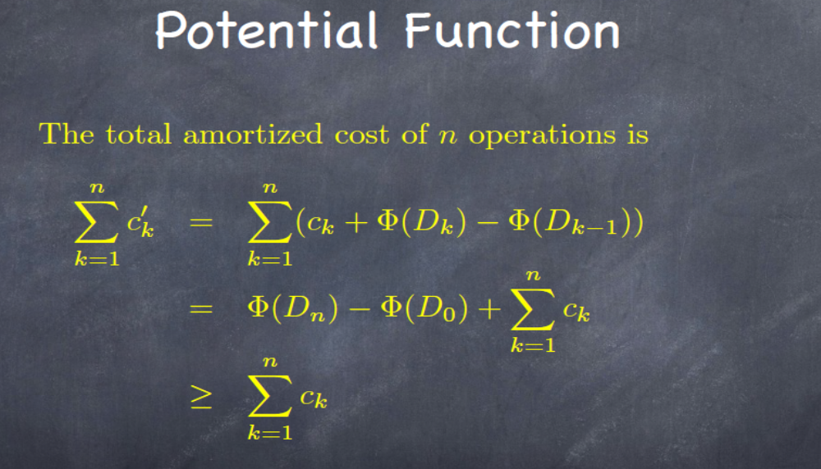

Slide 5
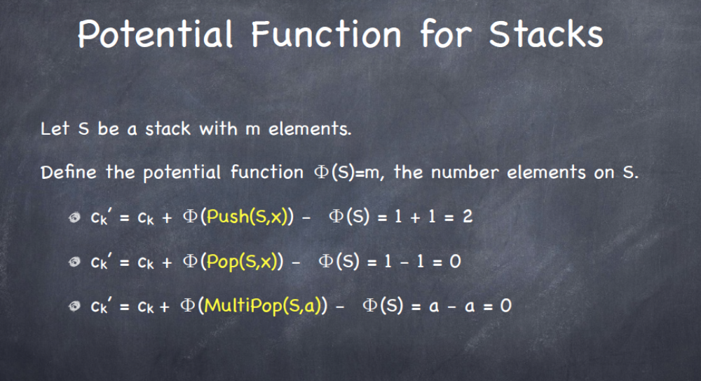

Slide 6
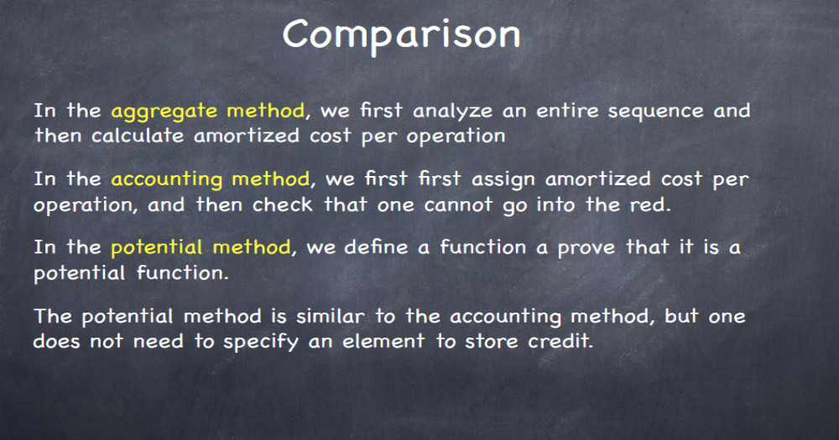

Slide 7
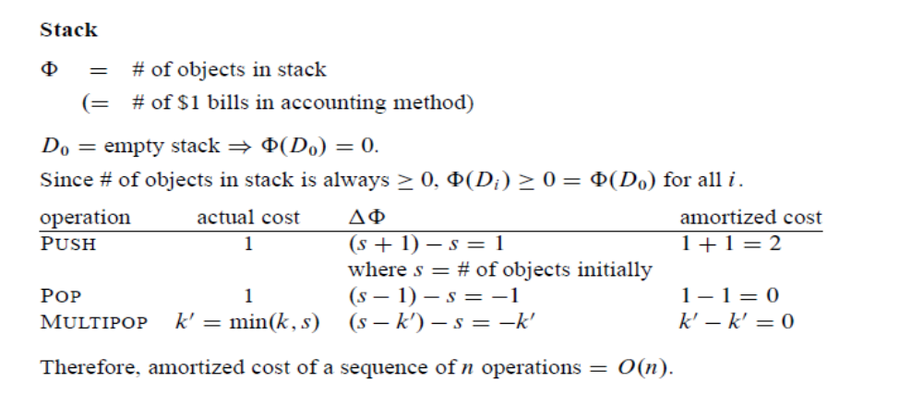
Potential Method

Slide 8
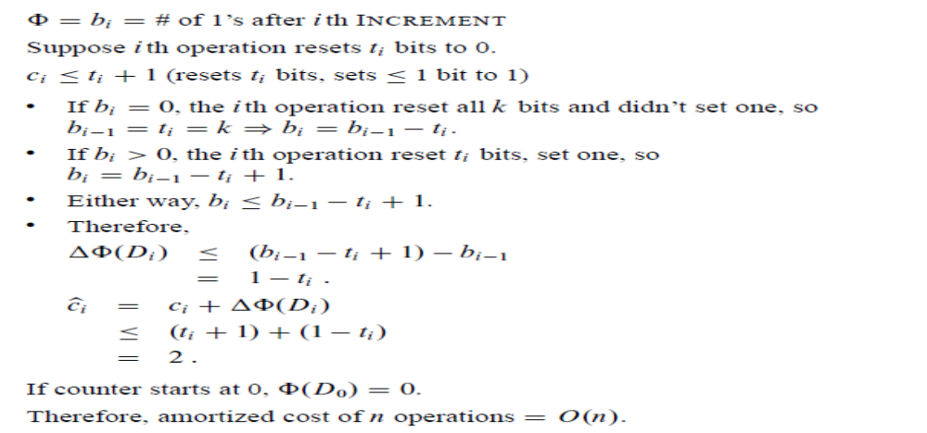
Binary counter

Slide 9
Exercise-1
Consider an ordinary binary min-heap data structure with n elements that support the instructions INSERT
and EXTRACT-MIN in O(lg n) worst case time. Give a potential function ф such that the amortized cost
of INSERT is O(lg n) and the amortized cost of EXTRACT-MIN is O(1), and show that it works.
The amortized cost of EXTRACT-MIN is 0, as all its actual cost is compensated

Slide 10
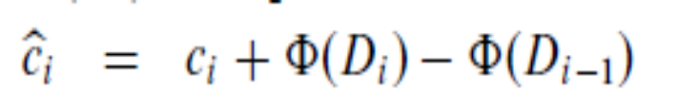
Exercise - 2
What is the total cost of executing n of the stack operations PUSH,POP, and MULTIPOP, assuming
That the stack begins with S₀ objects and finishes with S_{n} objects.
PUSH →Amortized cost 2
POP and MULTIPOP -→ 0
For n operations
Actual cost= 2n +S₀- S_{n} [If S_{n} ≥S₀]
=O(n)

Slide 11
Exercise- 3
Suppose that a counter begins at a number with b 1’s in its binary representation, rather than at 0. show that the cost of performing n INCREMENT operations is O(n).

Slide 12
Exercise-4
Show how to implement a queue with two ordinary stacks so that the amortized
cost of each ENQUEUE and each DEQUEUE operation is O(1).

